Slide 1
Systematic Literature Review: How is Model-based Systems Engineering Justified?
Ed Carroll Principal Systems Research Analyst
November 9, 2016
SAND2016-11485 PE
Notes:
Hello. Today’s presentation will be an overview of a systematic literature review that Bob Malins and I conducted on the question: “How is Model-based Systems Engineering Justified?”
Bob, are you on the line? If so, please take a bow.

Slide 2
MBSE Study Introduction What is the value of MBSE to Sandia?
Principle Investigator: Ed Carroll
Retired Naval Aviator
25 years in software / systems engineering
15 years in systems analytics and data management
Four questions were outlined for the MBSE study:
What does it look like? (Industry standards, guidelines, and manuals)
What can we learn from others? (Literature review & external visits)
What are we currently doing? (SMEs and MGRs, & pilot projects)
What is the path forward? (based on conclusions from above)
Pilots:
4 pilot projects, including: small, large, complex, hardware, software
External Visits
Lockheed Martin, JPL, Huntington Ingalls, USAF, US Navy, DOD, & DOE
Notes:
The scope of MBSE Value study is encapsulated in 4 questions:
What does it look like?
What can we learn from others?
What are we currently doing?
What is the path forward?
To answer these questions, we first surveyed the literature, which culminated into our Systematic Literature Review. Then we surveyed the industry standards, guidelines and manuals. We have conducted 33 interviews of systems engineering experts, and are in the process of interviewing managers. We are in the process of visiting external groups whom we feel have a particularly good MBSE program (those would Lockheed Martin, JPL, and Huntington Ingalls), as well as visiting our customers to gain their perspective. And we have 4 pilot projects planned where we will collect data to see if we can obtain demonstrable evidence.

Slide 3
Definitions - MBE vs. MBSE
Model-Based Enterprise – the tools, models, and infrastructure used to share design information across the enterprise that develops and supports the system
Model-Based Engineering -- Integrated use of models to define the system technical baseline across the full life cycle, across all disciplines, across all program members [models are the authoritative definition of the system]
Model-Based Systems Engineering – a specialized type of descriptive modeling used to create and analyze systems engineering information across the life cycle [the model is the authoritative definition for all systems engineering information]
Notes:
In making this presentation, I often find that there is some confusion about the definition of the terms I use. I hope this audience appreciates the differences in these three roles.
Model-based Enterprise – is, not too surprising, about modeling the engineering processes from an enterprise perspective.
Model-based engineering – typically refers to engineering design work performed by mechanical, electrical, software, and physics engineers.
Where model-based systems engineering is about using models to describe and analyze the system as a whole, tying together the models created by the other engineering disciplines into a cohesive product.
What makes these definitions significant is when the models become the authoritative source for the information, and any documentation produced from these models becomes simply a by-product.

Slide 4
Agenda
Introduction – What is the value of MBSE to Sandia?
Gathering metrics about MBSE
What is Systems Engineering?
Industry description (iterative processes)
What is driving us toward MBSE?
What is Model-based Systems Engineering?
Conclusions and Key Findings from my Systematic Literature Review
An MBSE approach provides significant advantage
Systems engineering improves engineering efficiency
MBSE Prevents Defects and Rework
Systems engineering needs to drive engineering processes
Skilled system engineers are needed
Prerequisites and Commitments
Notes:
This presentation started with an introduction of my study
I’ll follow with a brief description of what is systems engineering – just to establish my baseline for comparison
Then we will get into the meat of my findings and conclusions of my systematic literature review

Slide 5
Metrics Being Gathered
Gathered from existing processes:
SME and MGR use characteristics and opinions
Defect rates
Failure mode analysis – tracing, mistake proofing
Halt Hass, Fagen Inspections, CONOPS reviews
Interaction points, degree of completion, consistency
Compare to COQUALMO defect predictions
Level of Effort (cost and schedule)
compare manhours to $$ and schedule overage
Informal Assessment of SE Capability
gathered as a bi-product of project work already being conducted
Notes:
My approach to data collection on live projects is to use data that is either a bi-product of regular work or already being collected for other reasons.
This way the data contains the least biases and I am not adding workload to the project. I’ll work with the project teams to collect defect rates and level of effort data.
Defect prevention is reported to be the primary value to MBSE, and cost and schedule are always important indicators. I’ll attempt to map the level of effort to any baseline overruns, similar to the way other researchers have done, so that we can draw any correlations from their research.
In addition to establishing a baseline for defects and level of effort, I’ll attempt to conduct an assessment of the systems engineering capability of the project team members. This will provide another baseline to draw correlations from.

Slide 6
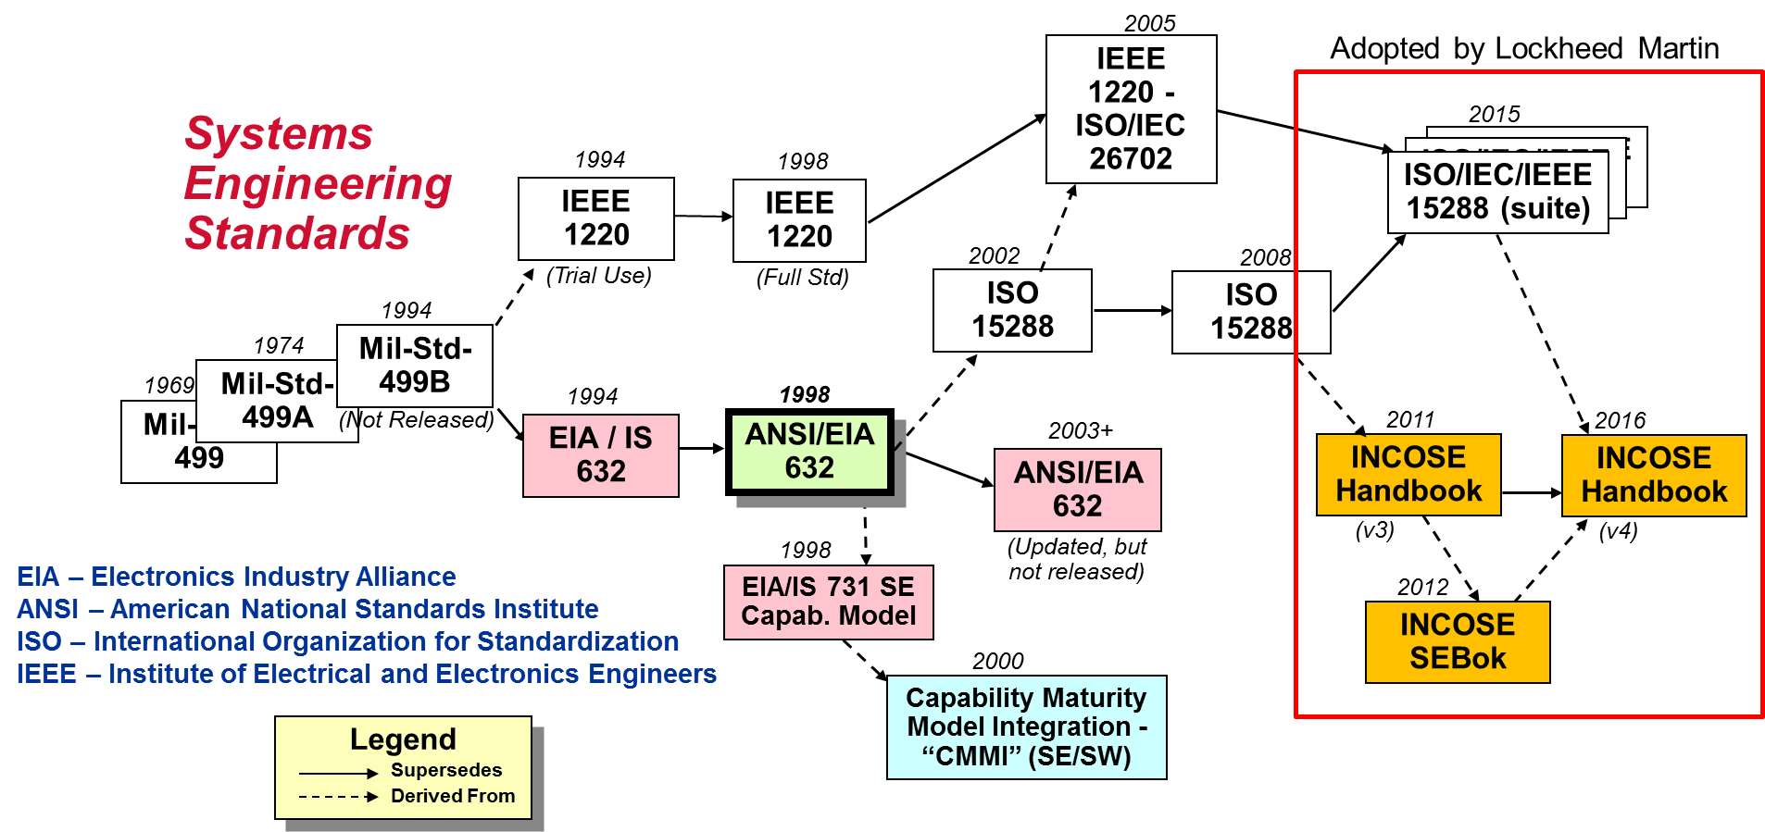
What are the Key SE Standards?
Figure 1: © Garry Roedler 2016 , adapted with permission
Notes:
To establish our baseline, we knew that we would be comparing document-based systems engineering with model-based systems engineering. However, we discovered that we needed to first gain a clear understanding of “What is Systems Engineering?” before we could develop a clear image of what model-based systems engineering is in comparison.
We started our definition of systems engineering with the industry standards, of which there are many:
ISO, IEC, IEEE, ANSI/EIA standards
DOD, DOE/NNSA, NASA, and Sandia guidelines
And The INCOSE Handbook
Over the past 10 years, there has been considerable effort spent to align the various standards. The industry standards are now primarily aligned around ISO/IEC/IEEE 15288 suite and the INCOSE Handbook/SEBok wiki-site: sebokwiki.org
“There is effort toward aligning the ANSI 632 standard, but that effort has been on-going since 2003 and is not complete yet.” Garry Roedler

Slide 7
The applicable standards
The industry standards have converged into ISO/IEC/IEEE 15288
Cooperative Technical Co-evolution Model
Acquisition Addendums
DOD SE Refs
(DAG: Ch 4; Sys Assurance; SoSE)
IEEE 15288.1 DOD Addendum
NATO AAP-48
ANSI/EIA 632
Drives lower level standards and user documents
ISO/IEC/IEEE 15288
SNL: R012, T059-62
NIST Security Standards (uses 15288 process framework)
Influence evolution
ISO/IEC, IEEE, INCOSE
Influence evolution
Drives SE Certification
NNSA DP Program Execution Instruction
NASA SE Handbook
SEBok evolutions gathered through wiki
SEBok
INCOSE SE Handbook
SEH evolves through
new versions
Significant Collaboration in this Co-evolution
Figure 2: © 2016 Garry Roedler, adapted with permission
Notes:
We’re finding that adoption of the now aligned standards is strong across the industry. For example,
Lockheed Martin have abandoned their internal SE manuals in favor of the ISO/IEC/IEEE 15288 standard and INCOSE Handbook
DOD has …
NASA has …
DOE has …
DOD/DAG SE References: Industry SE process standards that describe best practices in accomplishing SE include, but are not limited to, the following:
ISO/IEC 15288, Systems and Software Engineering-System Life Cycle Processes
ISO/IEC 26702, Application and Management of the Systems Engineering Process
ISO/IEC/IEEE 42010, Architecture Description
EIA 632, Processes for Engineering a System
Here is how Garry Roedler (one of the lead authors for the INCOSE Handbook explained the difference between the handbook, SEBoK, and the standards.
“The combination of the INCOSE SEBoK, SE Handbook, and 15288 are now revised with the bigger picture in mind regarding their interactions and alignment. The relationship is what I call the Cooperative Technical Co-evolution model.
SEBoK reflects the state of the art of SE. It uses the INCOSE SE Handbook and the standards as key resources. But it also includes current research and trends/evolving concepts, methods, etc.
The INCOSE SE Handbook reflects the state of the practice. It also uses the standards and to some extent the SEBoK as references, but identifies what is the consensus of the industry for current accepted concepts and proven practices. That is why the INCOSE SE Handbook is the basis of SE Certification and not the SEBoK. Since the Handbook is a snapshot of the state of the practice and the basis of certification it needs to be a stable baseline. So the handbook is only revised in 3-5 year time periods. Whereas, since the SEBoK reflects the state of the art and needs to capture incremental changes, it is revised every 6 months.
Versus the standard, the handbook and the SEBoK includes other systems and systems engineering concepts that are needed by people who perform systems engineering to better understand and execute SE. This includes things like systems thinking, system concepts, systems science, specialty engineering processes, etc. The additional items are those topics in the SE Handbook in chapter 1-3 and 8 to the end.” Gary Roedler
You might notice that there are no “model-based” systems engineering standards. My industry contacts involved in SE standards development confirmed that there are intentionally no MBSE specific process standards. All of the standard bodies assumed that an MBSE approach is a Systems Engineering approach - using models. That is not as simple as saying that apply an MBSE approach is to simply add a digital tool to SE, rather I interpret their premise to mean that whether or not you are using digital tools, the standards for good systems engineer remain the same. And if you read the standards, I think you will agree that they do not in any way preclude you from using an MBSE approach.

Slide 8
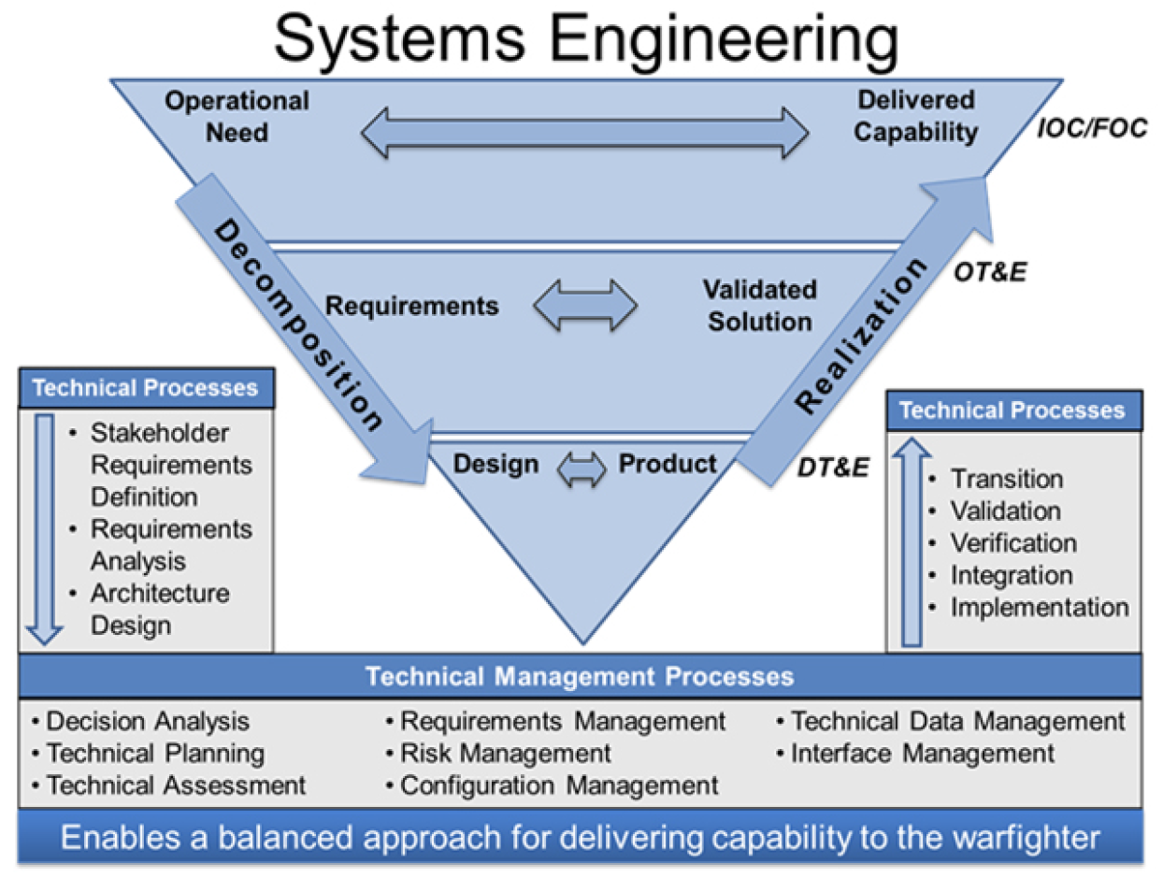
The industry standard processes
Figure 3: © the Defense Acquisition University
Notes:
The SE process are generally represented in a V formation, representing decomposition of the problem set down the left and realization up the right sides. This graphic from the Defense Acquisition Guide best presents the processes called out in all of the standards. Chapter 4 of the DAG is the primary SE guideline for DOD. I chose this graphic because it is the easiest to read.
According to the industry documents, there are two classifications of systems engineering processes: You can see the two classifications, Technical processes and Technical Management Processes
In my systematic literature review I concluded that one of the keys to a successful overall program performance is to have experienced systems engineers in positions of leadership for the SE technical management processes. I’ll say more about this later.

Slide 9
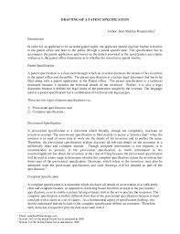
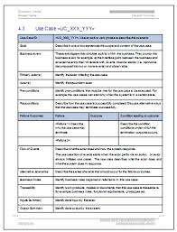
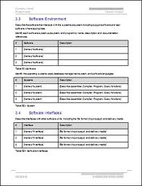
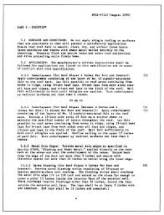
Why MBSE?
Complex system example:
Heavily document-based approach
over 6000 parts per system
Customer docs:
Text: 327 pages, over 750 mined requirements
Physical: 396 mined requirements
These led to system and major component requirements documents:
832 pages of functional requirements
232 pages of interface requirements
Documents do not address
Subordinate components
Environments
Dev Test plan
Qual plan
Maintenance/Ops Plan
Standards and Best Practices
Any production related requirements
How do I navigate this???
Figure 4
Notes:
Now that we have an idea of what systems engineering is (I’m assuming that you have read all of those standards, as I have – snore). Let’s first explore why we should even consider an MBSE approach.
Here’s an example from a real-life complex systems. Heavy document-based SE approach on a system with over 6000 parts.
Customer docs: Text: 327 pages, over 750 mined requirements
Physical: 396 mined requirements
These lead to system and major component requirements documents:
832 pages of functional requirements
232 pages of interface requirements
Does not address Subordinate components, Environments, Dev Test plan, Qual plan, Maintenance/Ops Plan, Standards and Best Practices, or any production related requirements
Can you imaging finding a errors, omissions, or other problems with requirements in a 832 page document? We are only describing requirements here. This list does not include the engineering design documents, drawings, tests results, etc. How can you think you have accurately traced all requirements through a paper document?

Slide 10
What is driving the industry to MBSE?
Others have said “how can we not use an MBSE approach?”
- Consider SNL’s agile, adaptable, affordable initiative
Systems are getting more complex
Customers want to reduce cost / schedule
Customers want guaranteed reliability
Modeling is prevalent in all engineering disciplines
Electrical, mechanical, physics-simulation, software
Data shows a positive ROI for using models to solve the problems of complexity, cost, and reliability
DOD is mandating models in contracts
ie., The Ground Based Strategic Deterrent SOW (section 3.2.3)
Nunn-McCurdy breach on the GPS III program – due to inadequate systems engineering at program inception, the Air Force said in a press statement.
Additive Manufacturing requires models
Notes:
So that was one example. Some people say that using a model-based approach will quickly become forced upon the industry, so I thought it would be instructive to review what is driving the industry toward model-based approaches. Models are seen as a way to control complexity, reduce cost, and prevent defects. All of the engineering disciplines use models in various forms, from electrical wiring diagrams to solid-spatial modeling and physics testing models. When I ask people in the industry how they justified going to an MBSE approach, many of them respond, “how could we not?”
The largest percentage of systems engineers work within the defense and space industry. So it should be important to the SE community to learn that the DOD has started incorporating mandates into contracts for models. For example, the Ground Based Strategic Deterrent SOW specifies a model-based systems engineering approach and specifies that deliverables be provided in model formats. An example of why the DOD is going this direction are revelations such as the GPS III program, where the Air Force attributed the Nunn-McCurdy contract breach to inadequate systems engineering at program inception. So the DOD sees MBSE as a way to improve systems engineering rigour.
And of course, future developments such as additive manufacturing creates products directly from models, although it is not immediately clear to everyone that the models for additive manufacturing should begin with systems engineering models.

Slide 11
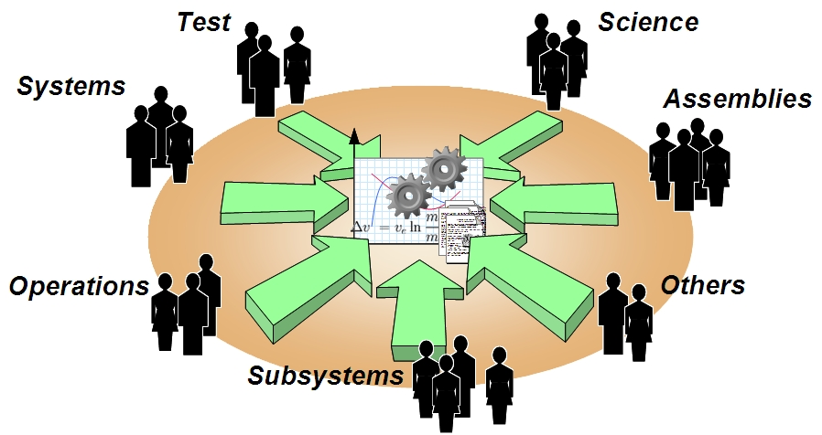
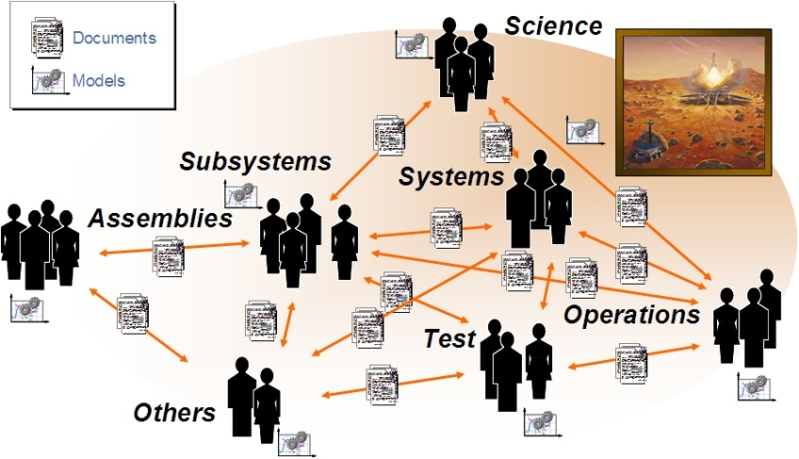
What Would MBSE Look Like … In Current Practice to Future Practice
Today: Standalone models related through documents
Future: Shared system model with multiple views, and connected to discipline models
Figure 5: © INCOSE, adapted with permission 2014
Notes:
INCOSE, provides this vision of the future for what MBSE would look like:
A shared system model with multiple views and interconnected to other discipline models
(such as the mechanical, electrical, and physics or simulation models).
The MBSE models become the glue that interconnects all of the other models,
And is an essential part of a Model-based Enterprise
(which encompasses MBSE, MBE-3D-mech/elect/structural/spatial/M&S).

Slide 12
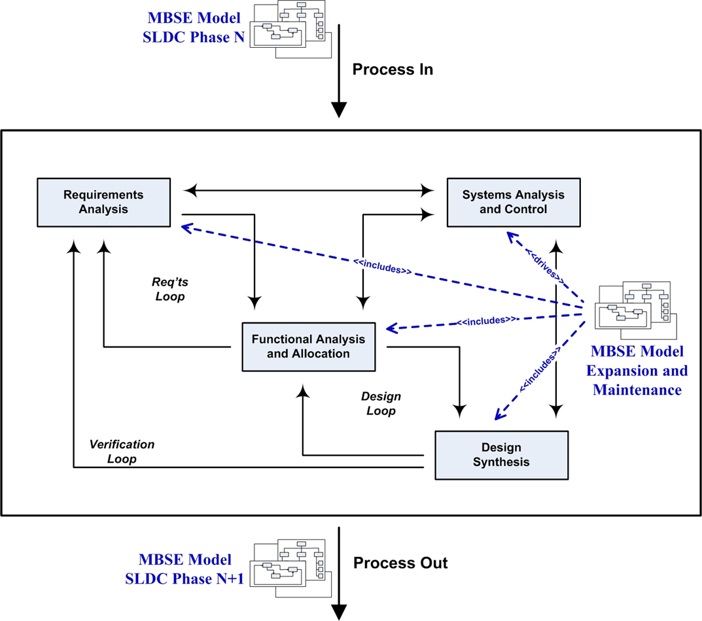
What SE Processes does MBSE overlay?
Figure 6: © Copyright ROI Training, Inc. 2016, adapted with permission
Notes:
As mentioned in my comments about standards, the essential SE processes remain the same. The difference now is that the information is captured in a digital model. The engineer still collects and analyzes requirements, ensures control of the overall system, through analysis, decomposes higher level requirements to functional levels and allocates those functions to the design, and synthesizes the design elements into the larger system picture.

Slide 13
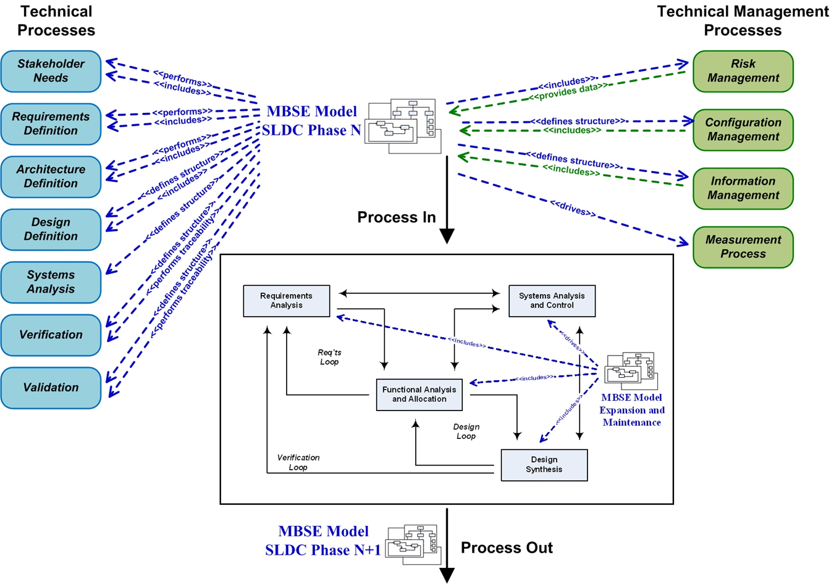
What is Different When Using MBSE?
The Model is the Center
of MBSE Effort
Figure 7: © ROI Training, Inc. 2016, adapted with permission
Notes:
The model tends to enforce greater rigor on the SE processes. Through model analyses - the requirements are analyzed for completeness, traceability, and integration. When change is needed either in the requirements, or from the design backwards to the requirements, analysis of the digital model will again enable analysis for omissions, lost interfaces, incompleteness of requirements, etc,. This analysis induced rigor prevents defects later in development lifecycle.

Slide 14
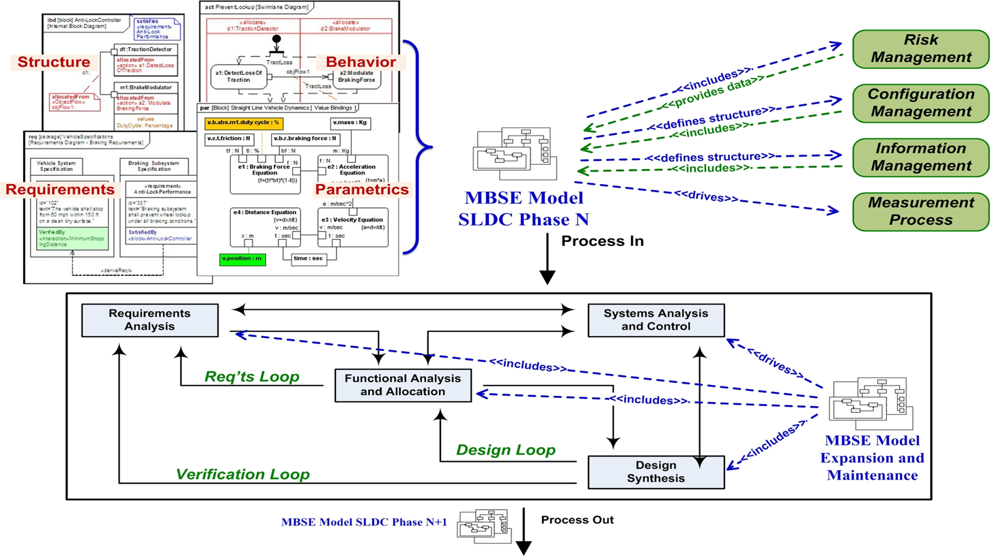
Overlaying MBSE to SE Foundation
Figure 8: © INCOSE, with permission 2012
Figure 9: © ROI Training, Inc. 2016, adapted with permission
Notes:
In a rigorous MBSE approach, every time there is some kind of feedback, the engineer goes back to the model for all adjustments. This is typically much more intense than in the document-centric approach.
Because it is generally easier to make changes to the model than it is to a configuration managed document, this maintenance effort causes the model to be much more complete than the paper documents. It also requires a correspondingly intense configuration management process, to ensure that changes are properly controlled.

Slide 15
Findings and Conclusions from Lit Rev
67 case studies justified by claiming benefits of:
Completeness, consistency, and improved communications
Or highlighted contributions to test and evaluation, V&V, concept exploration, design reuse and systems margin analyses
21 case studies justified with quantified results of:
Cost and schedule improvement
Finding defects and preventing rework
Case studies were from:
(67) 8 countries, 10 defense, 33 space, 5 non-defense, 6 commercial
(21) 4 countries, 12 defense, 5 space, 4 commercial, 6 used MBSE to develop complex weapon systems
Notes:
The systematic literature review addressed the question: “How is the change from a document-based systems engineering approach (DBSE) to a model-based systems engineering approach (MBSE) justified?”
We found 20,000 documents published electronically.
We narrowed that to about 1,000 documents that came from relevant industries.
We then down selected 88 that focused on justifying either systems engineering or MBSE.
67 of these documented their justification by stating benefit claims of completeness, consistency and improved communication, or by highlighting contributions to test and evaluation, V&V, concept exploration, design reuse, and system margin analyses. These 67 articles came from 8 different countries, 10 from defense, 33 from aerospace-space, 5 from non-defense government applications, 6 from commercial enterprises, and 12 were academic papers on defense related systems.
The remaining 21 case studies defined how the investment in a systems engineering or MBSE approach was justified using quantifiable metrics focused at either cost and schedule improvement, or finding and avoiding defects.
They came from 4 countries, 12 from defense, 5 from space, and 4 from commercial enterprise, with 6 of these published as an academic treatise.
9 case studies justified a systems engineering approach without specifying the use of models and 12 used an MBSE approach.
We won’t take your time to go through the details of our methodology. Our report contains that information, and if you are interested, I can provide you with a copy. This presentation will focus on the conclusions of our review.

Slide 16
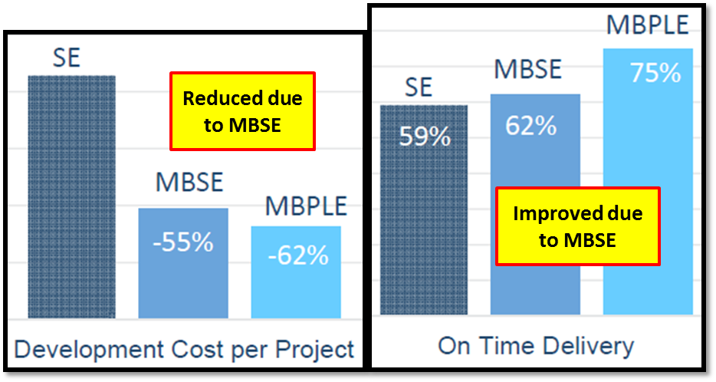
MBSE Provides Significant Advantage
MBSE is an extension of Systems Engineering,
And model-based product line engineering is an extension of MBSE
Figure 11: © PTC inc. 2014, adapted with permission
Notes:
The first conclusion is that there is a significant advantage to project performance by applying a systems engineering approach, and that applying an MBSE approach further significantly improved project performance.
For example:
In the graphs shown, the authors (Tommasi and Vacca) compared performance improvement after implementing systems engineering processes, an MBSE approach, and an MBPLE (model-based product line engineering) approach (from 667 systems engineers).
The authors make an important statement that will carry throughout the other case studies reviewed, in that MBSE is only an extension of systems engineering. The two approaches share the same engineering role with a program. In that regard, you may see the term SE and MBSE used interchangeably in this presentation.
11 case studies reported that applying an MBSE approach significantly improved project performance beyond that of a systems engineering approach. This was attributed to processes that enable: stakeholder and requirements stability, concept exploration, design reuse, and margin analyses.
These are the MBSE techniques that enable defects to be found and fixed early in the SDLC. Defects and rework were the cause of significant project performance degradation, and an MBSE approach was shown to limit this impact.

Slide 17
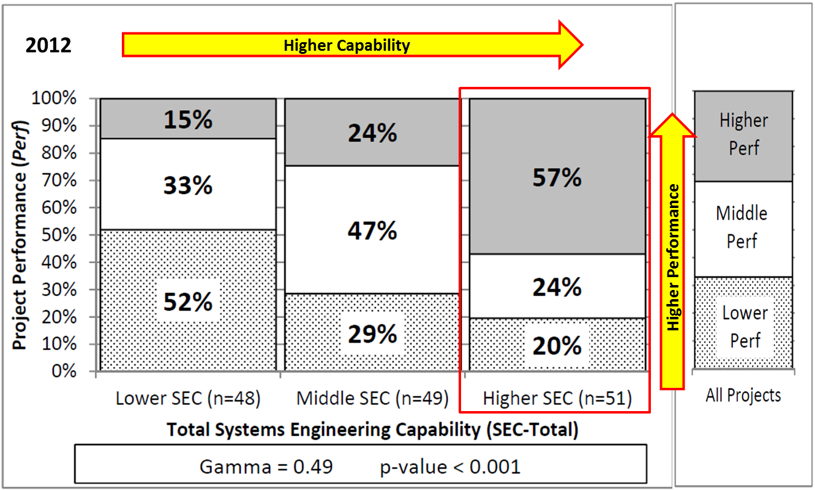
SE Improves Engineering Efficiency
Figure 12: © Carnegie Mellon University 2012, adapted with permission
Notes:
Another conclusion is that A SE approach (and by extension, an MBSE approach) improves overall engineering efficiency.
This graphic from a study by Elm and Goldenson of Carnegie Mellon, shows that 57% of respondents achieved a higher performance for projects that employed a higher level of systems engineering capability.
Several case studies stated that an MBSE approach could make a complex system development effort more efficient. Efficiency was mainly attributed to requirements completeness, consistency, and communication. Other benefits highlighted were gains from using an MBSE approach for processes such as: test and evaluation, verification and validation, concept exploration, design reuse, and system margins analyses.
One finding that concerned us was that projects which only used systems engineering or MBSE for requirements management rated in the low performance section. And, it was shown in other case studies that using an MBSE approach only for requirements did not leverage the capabilities of an MBSE approach to prevent defects in later stages.

Slide 18
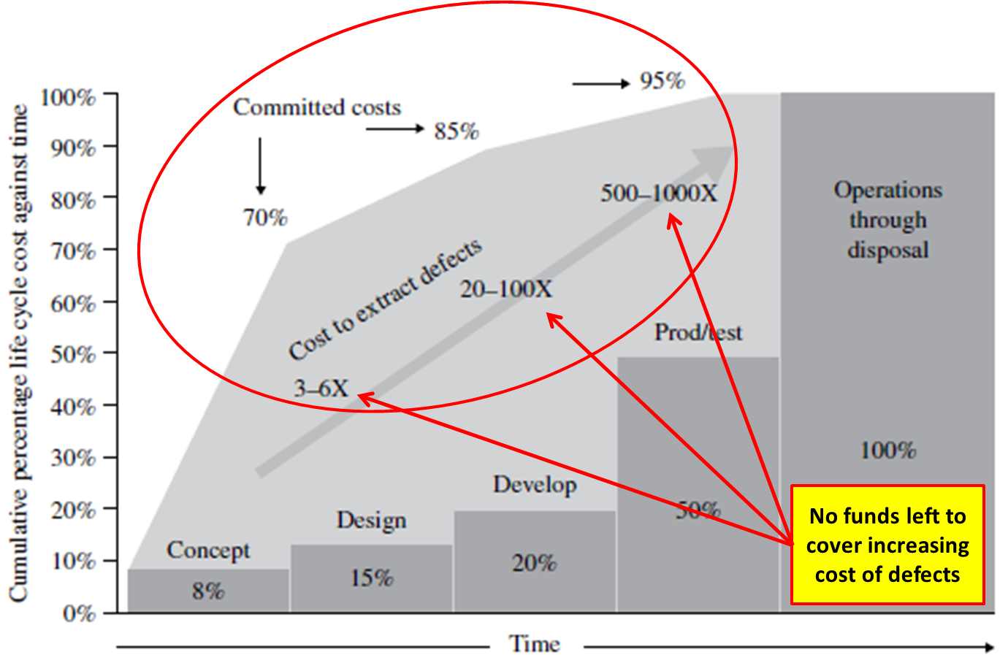
MBSE Prevents Defects and Rework
Figure 13: © Raytheon Company 2011, Defense AT&L
Notes:
The primary conclusion is that an MBSE approach prevents costly rework. 12:21 case studies presented evidence confirming that an MBSE approach provides significant capability to find defects early in the SDLC (when they can be fixed with less impact) and thus mitigate the risks to cost, schedule, and mission by preventing rework late in the life cycle.
The reason this is so important is evident from this DATL graph adapted by Saunders, many complex defense system programs commit total program cost in the early phases of the SDLC. The figures illustrate how cost increases as a product realization advances. Rework late in the SDLC poses significant risks to the program for cost and schedule overruns, because there is little room to absorb rework in the cost structure.

Slide 19
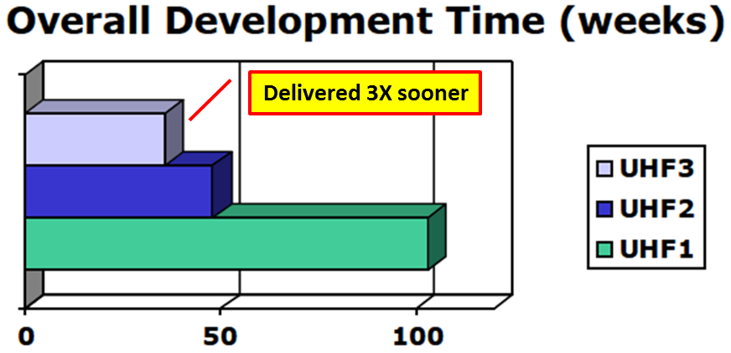
SEs Need to Drive Engineering Processes
To effect delivery, SEs must drive their processes
First change the model, then change the system
High access to systems management, who pays attention
Figure 14: © The Boeing Company 1995 , adapted with permission
Notes:
A corollary conclusion is that Systems engineers have a role in driving the engineering processes.
Along with applying a systems engineering or MBSE approach across the SDLC, the greatest performance success was achieved when systems engineering held a technical process leadership role.
The graph here shows a comparison between three Universal Holding Fixtures projects. The author (Frantz) attributed success in the project that delivered 3X sooner than the worst UHF project to:
High access to systems management disciplines and support – Stating that systems management paid high attention to concerns from the systems engineers
Adherence to functional specification, three examples were given:
All specifications were updated as the design matured
Specifications were followed and adhered to in all aspects of design and build
Changes were controlled by a formal change board
And the project employed a formal internal and external design review approach – Stating that design engineers paid at least moderate attention to the systems engineers
My experience in my 25 years of leading software engineering projects was that the SE’s were some of my most senior engineers, and I used them to help me manage the engineering processes from an overall systems perspective.

Slide 20
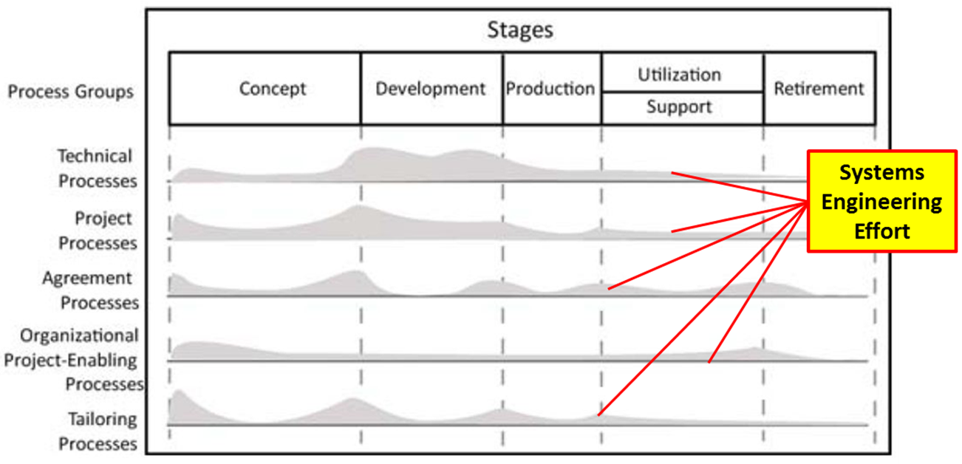
Skilled SEs are Needed to Drive Engineering Processes
Delivery times are not effected by data entry clerks
Systems Engineers must be well trained engineers
MBSE employs new techniques, tools, and processes
Figure 15: © INCOSE adapted with permission 2012
Notes:
A key finding supporting SE leadership, and stated in several case studies, was that there is a need for skilled engineers.
This graph (by Mornas et al) identifies the processes where successful case studies employed systems engineering to lead and participate in. Notice two things, 1) that SE’s do much more than requirements, and 2) that the SE effort extends throughout the SDLC
When an MBSE approach is only applied for requirements management, the approach cannot be leveraged to prevent defects and rework late in the life cycle. It is in preventing rework in these later phases when the greatest cost and schedule savings are realized.
A number of the case studies addressed the general lack of skilled systems engineers, and skilled MBSE engineers in particular, as a major hindrance to implementing an MBSE approach. For example:
If the models are to provide benefit to later phases of the program, they must be managed and kept up to date.
Design engineers need a basic understanding of an MBSE approach in order to fully utilize the information generated by the systems engineers.
Both engineers and stakeholders are accustomed to reviewing documents rather than MBSE model artifacts
Resulting in cultural resistance to the fundamental MBSE process of "first change the model and then the documents"
The greatest challenge to a successful implementation of an MBSE approach may be overcoming cultural resistance

Slide 21
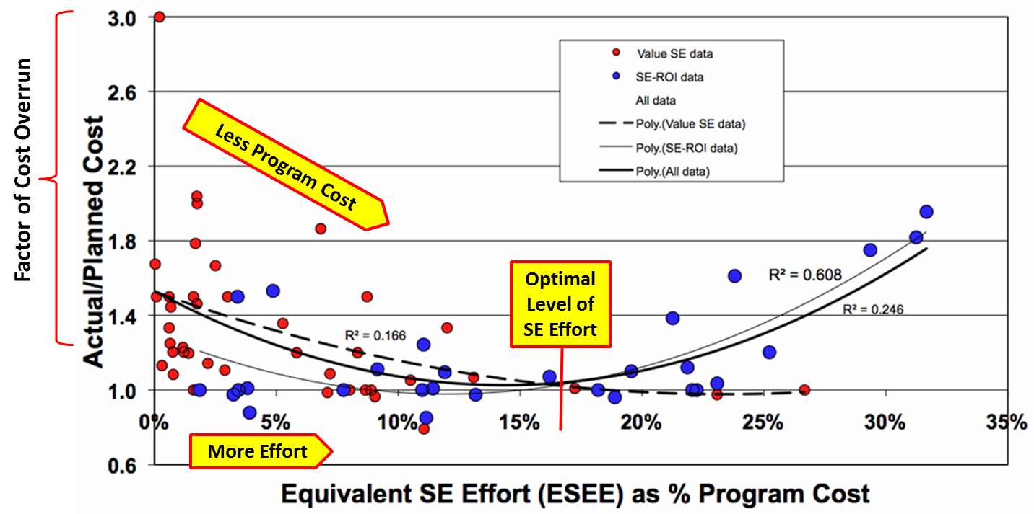
The data shows an optimal SE staffing at 12-17% of total
Figure 16: © Eric Honour 2013, adapted with permission
Notes:
An important large study of defense and space system programs by Eric Honour correlated a significant positive overall program performance with the level of systems engineering effort and identified an optimal level of SE effort to be between 12%-17% of total program effort. I find this graph interesting, because I rarely see this level of systems engineering effort, until after a major program failure.
Honour also calculated a project performance advantage of 7:1 over projects that did not use a systems engineering approach.
The statistically significant correlation between good SE processes and good overall program performance seems to say that if you have good SE processes, and you apply a modeling approach, you should beget a good MBSE approach. And, you should expect to achieve good program performance. What changes is that the model becomes the center of effort - for communication, technical processes, and technical management processes.
Note that the underlying presumption is that you have at least good MBSE processes.
My industry contacts involved in SE standards development further confirmed this, in that all of the standard bodies assumed that an MBSE approach is a Systems Engineering approach, using models.

Slide 22
Adding MBSE to the SE Foundation?
Good SE = Good Program Performance
Good SE → begets → Good MBSE
Good MBSE = Good program Performance
The model becomes the center of information
For Communication – across team and across program
For Technical Process Performance
For Technical Management Processes
Notes:
Here’s a math word problem for you. If good systems engineering = good program performance, will good MBSE = good program performance?

Slide 23
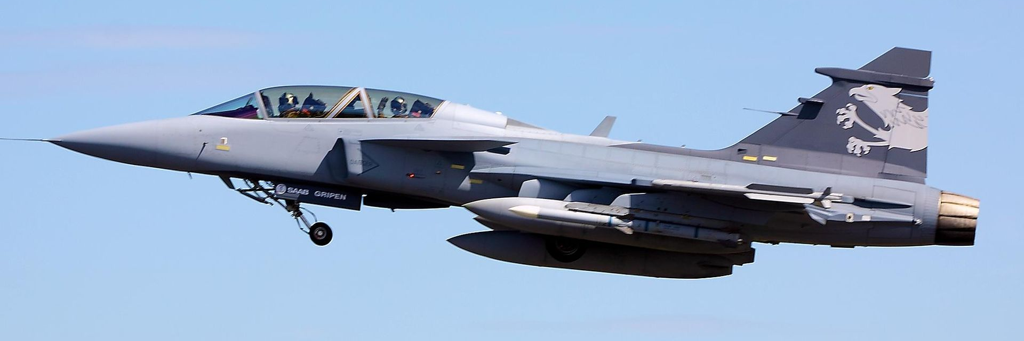
MBSE Provides Significant Advantage
Simulation
Flight-test
Figure 17: © INCOSE 2014, adapted with permission
Figure 18: © by-sa 2.0 Tim Felce – Gripen – RIAT 2010
Notes:
A study from Saab Corporation (by Bill Sweetman) that documented how through a combined MBSE/MBE (3-D modeling) approach Saab was able to find 70% of defects in the simulation stage, instead of the flight-test phase on the JAS 39E Gripen fighter jet. He explained that previous versions of the jet included 70,000 written documents, where the 39E had none.
Where the industry standard is to reach a near-optimal return on investment at the 180th aircraft produced, Saab wants to reach that stage by the 30th aircraft and cut the number of work hours taken on the first 100 aircraft by half.

Slide 24
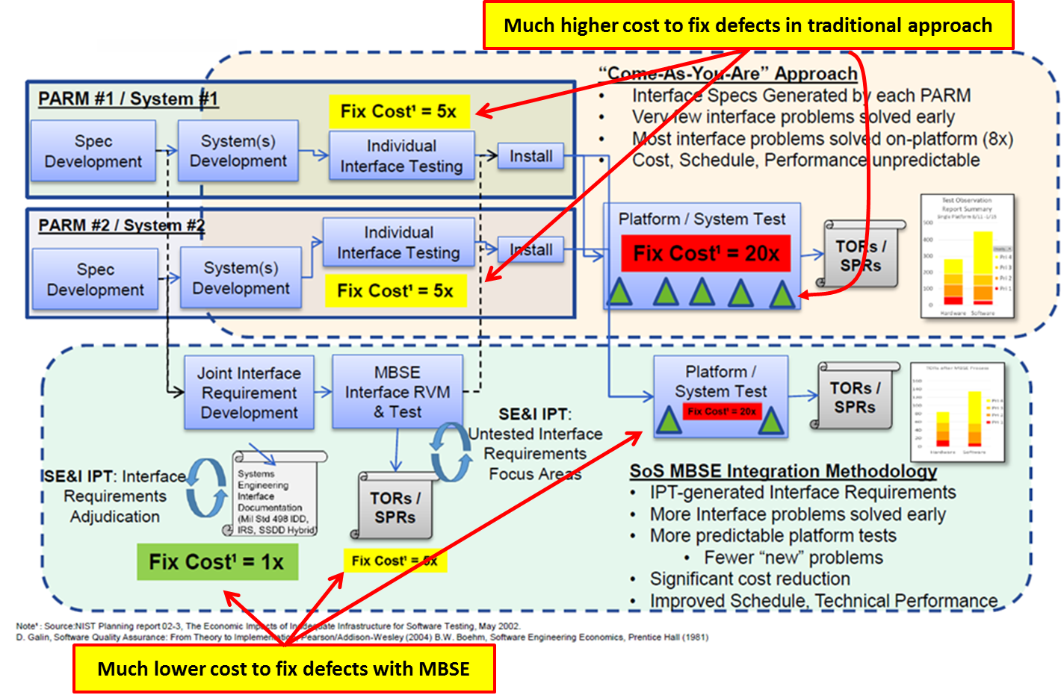
MBSE Avoids Rework
Figure 19: © Lockheed Martin Corporation 2015, adapted with permission
Notes:
Here’s an example (from Tyreman et al) that showed how they reduced or avoided costly rework on a billion dollar nuclear submarine program.
The beige section is the program cost impact to fix errors before applying an MBSE approach
The green section shows the cost impact after applying an MBSE approach
The author is trying to show that most of the defects were found early and fixed at 1X cost, with only a small amount at the 5x and 20X figures.
Notice that the “Fix Cost =“ blocks indicate the cost to fix an error at that stage of the SDLC, and the size of these indicators indicates the quantity of errors found and fixed at that cost. For example, see how large the red 20X figure is in the beige section and how small it is in the green section.

Slide 25
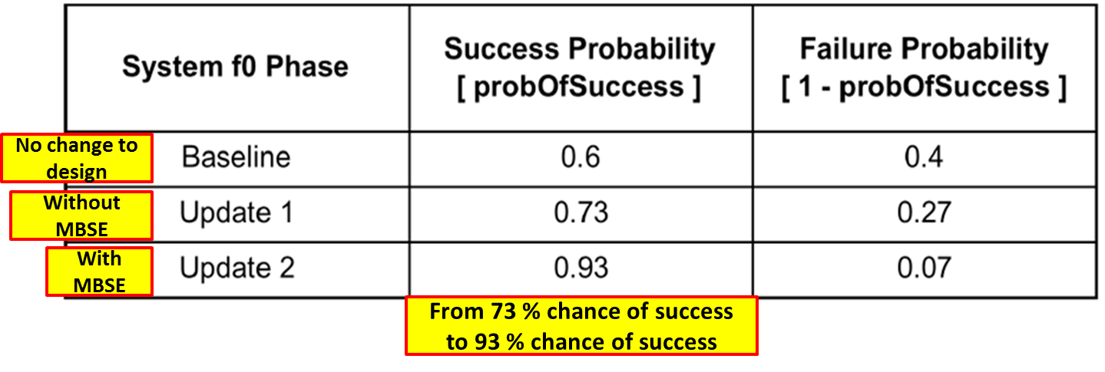
MBSE Avoids Rework
Figure 20: © Rafael Mareni Perez 2014, adapted with permission
Figure 21: © Raytheon Company 2011 (DAT&L)
Notes:
In an interesting NASA case study, the author (Perez) documented how the use of an MBSE approach improved the probability predictions of mission success.
He explains that risks analyses are typically conducted late in the design cycle, when design changes are difficult to implement. To improve this process the team evaluated the use of failure analysis integrated into the system architecture model managed through an MBSE approach to enable engineers to make risk-informed system modification decisions early in the design process. His results showed an improved probability of mission success from 60% to 73% and then to 94%.
In another case study, the author (Steve Saunders) showed how his team reduced the number of defects by 68% after implementing an MBSE approach.

Slide 26
What are the keys to effectiveness?
From our Systematic Literature Review of the industry, the following findings were reported as keys for effectiveness:
Engage Systems Engineers as engineering process leaders
Diligently perform defined (iterative) processes
Systems Engineering effort is highest early in the project
The optimal SE staffing is up to 12-17% of total program staffing
Notes:
To summarize, our literature review found that the best practices employed in the industry to achieve success from an MBSE approach include (these four area):
Engage systems engineers as engineering process leaders – not to tell the mechanical engineering lead what to do, but to take the leadership in managing requirements, architecture, and traceability.
Diligently perform the defined processes iteratively throughout the SDLC – the systems engineer is the one who is always evaluating whether a requirement has changed and the impact of that change.
Projects should expect to take extra systems engineering effort early in the project, and apply much more effort to systems engineering than is typical across the industry.

Slide 27
Engage System Engineers as technical leaders of these processes
Figure 22: © the Defense Acquisition University
Notes:
When I say engineering process leadership, I am referring to the Technical Management Processes defined within this red box. One could think of this as leading the systematic or engineering processes. Unlike the other engineering disciplines, only the Systems Engineer discipline is charged to look at these processes from the total system perspective.

Slide 28
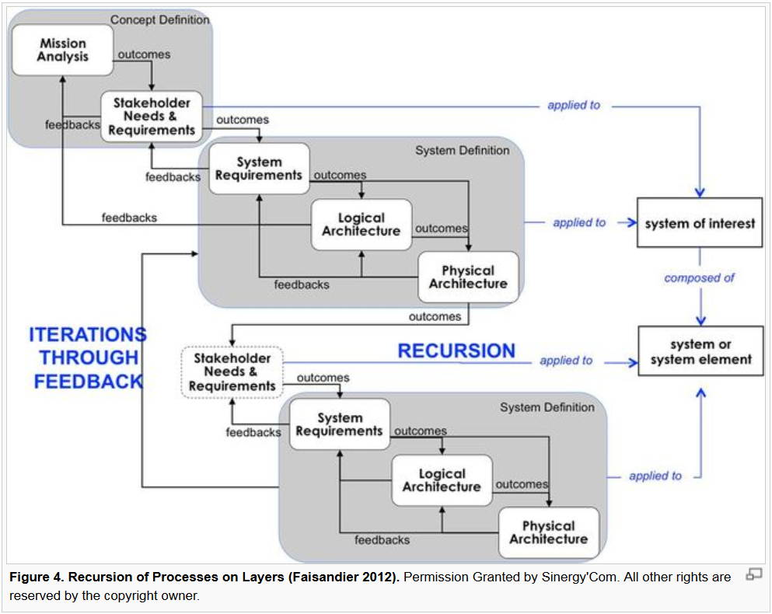
Key Processes – Iterate through feedback
Figure 23
Notes:
As mentioned earlier, a key to success is engineering diligence. At each project phase, the Systems Engineer diligently iterates though analyses of requirements and architecture. Synthesizing that information into the system design.
These tasks are re-iterated through all of the project lifecycle phases.
Another way to think of these systems engineering processes is to think of an iterative feedback loop that recursively refines and updates through needs, requirements, and architecture throughout the project lifecycle.

Slide 29
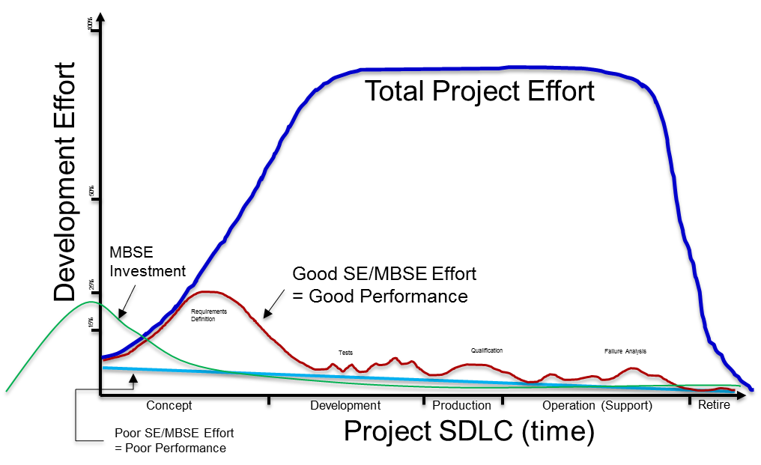
SE Effort is highest early in project
Figure 24
Notes:
I mentioned earlier that one of the keys for effectiveness found in our systematic literature review was this comparison between good SE/MBSE and poor SE/MBSE effort. In a good SE/MBSE approach, there is an increased effort early in the project to identify complete requirements, communicate those requirements throughout the stakeholders and development team, and to identify all of the interfaces. This increased early effort was shown to have a significant impact on defect rates later in the lifecycle – due to greatly reduced requirement omissions and errors.
I show the MBSE investment as a separate line, to show that there are two early effort swells. The green line represents the one-time investment (the initial modeling learning curve), while the red line recurs for each project, representing the early project investment to understand the requirements.
The Initial investment represents tools, training, and learning curve to become a proficient MBSE practitioner.
On the project level, we think that modeling enforces attention on details, tending to increase the work effort earlier.
NOTE:
Model reuse and defect prevention draw the effort curve down. I did not show this, because it made for a muddy graphic.

Slide 30
Prerequisites
Well documented SE processes that spans the SDLC
Trained systems engineers
Access to training in the SE processes at SNL
Defined processes for model management throughout the SDLC
Invest in full scale MBSE tools
Notes:
There are a number of prerequisites that were expressed by the case studies that any organization must employ in order to implement a successful MBSE approach. These prerequisites represent investments by the organization in its staff and processes.
The enterprise must have a mature, well-documented, and enterprise-wide SE process that spans from requirements development and analysis through system test and qualification (or V&V in the case of software intensive systems).
The enterprise must have a cadre of trained systems engineers with at least moderate skill in employing MBSE tools and techniques, and whose MBSE roles are clearly delineated from the more traditional roles.
The enterprise must make available to all the engineering staff a basic level of training in the MBSE processes (so that they understand the value of the models and what to expect from the systems engineers) and in how to read MBSE artifacts (so that they can interpret information provided from the MBSE processes).
The enterprise must define MBSE model management processes in order to create, update, and maintain the MBSE models throughout the full lifecycle and to derive engineering artifacts from the models at each stage of the system development lifecycle.
The enterprise must invest in full-scale MBSE tools (not requirements management tools) and tool-use procedures must be institutionalized (all teams must use compatible tools).

Slide 31
Commitments
Initiate modeling with appropriate staffing levels at the beginning of a program
Configuration manage the model “change the model first, then the design”
Provide continuous resources to maintain the models throughout the SDLC
Provide MBSE resources and models to support qualification
Provide appropriate computing infrastructure throughout SDLC
Notes:
Once the prerequisites are met, each program in the organization would need to make the commitment to employ an MBSE approach in the following manner:
Initiate MBSE model development at the beginning of the program processes (requirements phase) and resource the systems engineering effort sufficiently, including MBSE work (could be 15% of program costs).
Commit to making the MBSE models the centerpiece SE artifact for converting requirements into designs ("first change the model, then change the design").
Provide continuous resources to update and sustain the models and employ them as the basis for design reviews and verifying requirements within design artifacts, using the models to improve understanding of the impact to the design caused by changes.
Provide continuous resources to employ the models as the basis for defining system testing, qualification, and requirements verification plans.
Support an MBSE approach with appropriate sustained computing infrastructure (licenses, repositories, access controls, archives, and processes) throughout the system life cycle.

Slide 32
Orion - Human Space Flight
“Orion was designed from inception to fly multiple, deep-space missions. The spacecraft is an incredibly robust, technically advanced vehicle capable of safely transporting humans to asteroids, Lagrange Points and other deep space destinations that will put us on an affordable and sustainable path to Mars.”
Lockheed Martin Space Systems
Denver, CO
100% system reliability required
Model-centric customer (NASA)
Core MBSE Team
Figure 25: © NASA Photo
Notes:
Here is an example of a successful program, where some of the success is attributed to their MBSE approach.

Slide 33
Europa Exploration Mission
“This effort entails a highly complex integration of extensive modifications and numerous subsystems which must seamlessly interface with each other in order to meet the NASA ‘no fail’ mission.”
JPL
Pasadena, CA
Model-driven customer (NASA)
100% digital design and documentation
Figure 26: NASA/JPL photo
Notes:
And here is another program where at least some success is attributed to their MBSE approach.

Slide 34
References
Key Systems Engineering Standards, © Garry Roedler 2016, adapted with permission
System Engineering Standard Relationships, © Garry Roedler 2016, adapted with permission
Systems Engineering “V”, The Defense Acquisition University
How do I navigate
What Would MBSE Look Like graphic © INCOSE, with permission 2014
What SE Processes, © ROI Training, Inc. 2016, adapted with permission
What is the Difference, © ROI Training, Inc. 2016
Overlaying MBSE on SE, © INCOSE 2012
SE Foundation, © ROI Training, Inc. 2016, adapted with permission
What does MBSE Look Like
MBSE Advantages, © 2014 PTC Inc., Professional Paper, November 24, 2014, adapted with permission
SE Improves Efficiency, © Carnegie Mellon University. November 2012, adapted with permission
MBSE Cost Model, © Raytheon Company 2011, Published in the Defense AT&L (public domain)
Overall Development Time, © The Boeing Company 1995
Engineering Processes, © INCOSE, with permission 2012
Optimal SE Staffing, © Eric Honour 2013, adapted with permission
Early Defect Detection, © INCOSE, with permission 2012
JAS 39E Fighter Jet, © by-sa 2.0 Tim Felce – Gripen – RIAT 2010
Rework Avoided, © Lockheed Martin Corporation 2015, adapted with permission
Failure Probability, © Rafael Mareni Perez 2014, adapted with permission
Specification Defects, © Raytheon Company 2011, Published in the Defense AT&L (public domain)
Systems Engineering “V” (2), The Defense Acquisition University
Key Processes Iterate, © Faisandier 2012
SE Effort Early in SDLC
Orion Human Space Flight, NASA photo
Europa Exploration Mission, NASA/JPL photo

