Slide 1
System Architecture, the Missing Piece of Engineering Education
Eric B. Dano, Ph.D.
BAE Systems, Electronic Systems (ES)
eric.b.dano@baesystems.com
Not export controlled per ES-CEMA-021521-0057

Slide 2

Bottom Line Up Front (BLUF)
The majority of a system’s cost and realized capabilities are based on the derived system architecture (e.g. resilience, modularity, supportability, etc.).
Teaching system architecture at the undergraduate level is difficult due to the “art” (holistic thinking, heuristics, system synthesis) and ”science” (allocation, aggregation, partitioning) sides of system architecture. Learning also benefits from experience and domain knowledge.
System architecture can be taught within an organization or at the graduate level. However, to be successful, its prerequisites must be taught at the secondary and undergraduate levels to ensure students have the prerequisites to learn system architecture
An education in System Thinking will be shown to be a critical prerequisite to system architecture and other domains. Implementable within an existing engineering curriculum
A proposed approach will be described and applied to both a defense system, and a humanitarian aid system to emphasize the broad applicability
Not export controlled per ES-CEMA-021521-0057

Slide 3
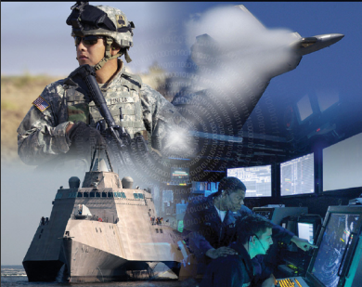
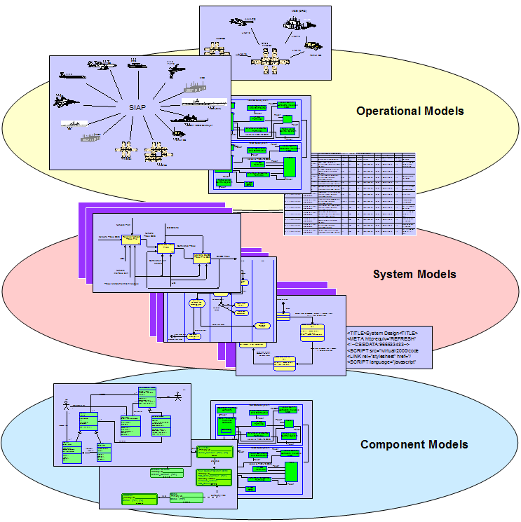
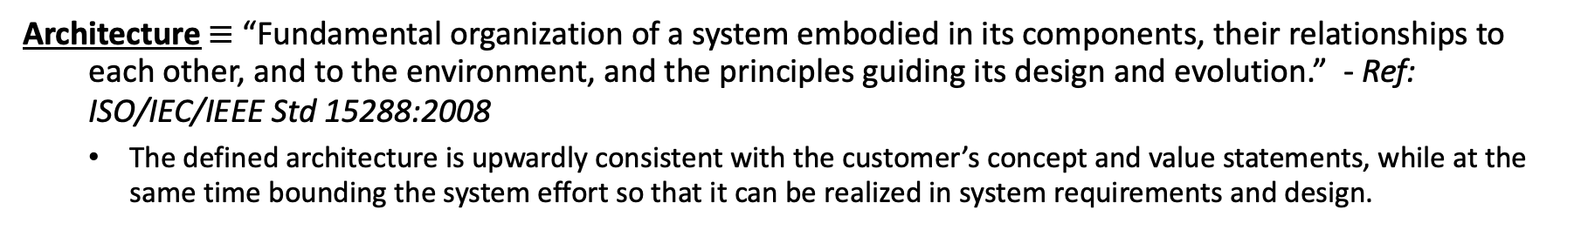
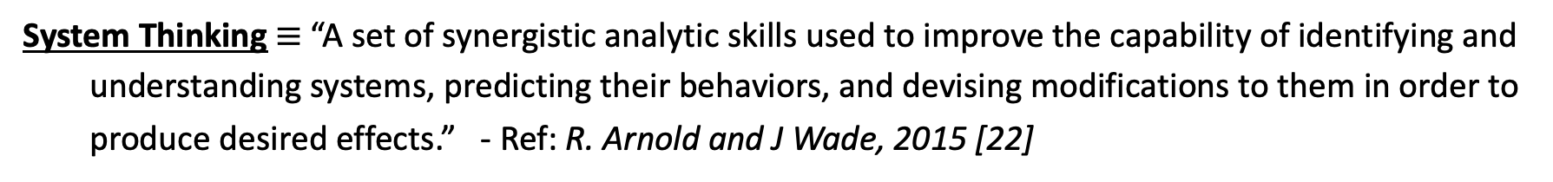
Definitions
Architecture $≡$ “Fundamental organization of a system embodied in its components, their relationships to each other, and to the environment, and the principles guiding its design and evolution.” - Ref: ISO/IEC/IEEE Std 15288:2008
  The defined architecture is upwardly consistent with the customer’s concept and value statements, while at the same time bounding the system effort so that it can be realized in system requirements and design.
System Architecture
Customer
Architect Creates a Balanced Architecture
Problem Space
Realizable Solution Space
System Thinking $≡$ “A set of synergistic analytic skills used to improve the capability of identifying and understanding systems, predicting their behaviors, and devising modifications to them in order to produce desired effects.” - Ref: R. Arnold and J Wade, 2015 [22]
Not export controlled per ES-CEMA-021521-0057

Slide 4
System Architecture Prerequisite Elements
SA Prereq. | Methods | Ref.
Classical Methods (Domain Independent) | Understanding the scientific method/trades/analyses Performing sensitivity and error analysis Performing architectural artifact generation Performing functional decomposition/system synthesis | [8], [9] [6] [4], [6] [10], [11]
System Thinking (Mostly Domain Independent) | Option generation/brain storming/conceptual Design Perform holistic thinking/finding highest level objectives Incorporating multi-stakeholder viewpoints Ability to focus on elements providing highest value Using heuristics/design patterns Using analogies to create options Understanding system hierarchical structures, elements, and complex interactions between them | [4], [6] [4], [6] [4], [6] [4], [6] [5], [12] [1], [6] [7]
Modeling & Simulation (Mostly Domain Independent) | Implementing System/Physics/Environment Models Using Modeling Languages and Frameworks (e.g. SysML, UML, etc.) Performing Monte Carlo analysis/Analytics Creating System Simulations | [13]
Formal Methods | Using Deterministic methods w/ Invariant Contracts Using Stochastic methods w/ Flexible Contracts | [14], [15]
Implementable
In Undergraduate Engineering
Not export controlled per ES-CEMA-021521-0057

Slide 5

System Thinking Competencies
- Ref: R. Arnold and J Wade, 2015 [22]
Basic System Thinking
Option Generation
Concept of Holism
Understanding System Structure at Different Scales and associated interactions
Stakeholder Identification
Analytic Skills/Scientific Method
Advanced System Thinking
Understanding Dynamic Behavior
Understanding feedback
Understanding Non-Linear Relationships
Differentiating types of stocks, flows, variables
Reducing Complexity
Basic System Thinking should be integrated directly into existing secondary/undergraduate courses, labs, projects and capstones
Advanced Systems Thinking lends itself to organizational training
Not export controlled per ES-CEMA-021521-0057

Slide 6


Implementing Systems Thinking in Undergraduate Education
Lecturing/Mentoring
Hands-on projects
Case studies/Heuristics
Experimental Systems Engineering (ESE)
Exposure to the various multi-discipline system stakeholders
Conducting background research
The lectures, projects, case studies and ESE should be integrated directly into all science and engineering undergraduate courses
The student’s projects should purposely be selected to cover multiple domains, and include both well-defined systems, and ill-defined systems such as complex socio-technical systems, and Systems of Systems.

Slide 7

System Architecture/Systems Thinking in Organizations
Continue systems thinking learning/mentoring:
Experience on assigned projects
Performing trades/analyses
Professional development
In-house training courses
Experience in multiple domains/technologies
Experience with multiple stakeholders
Learning the art and science of deriving and documenting a complex system architecture:
Functional architecture
Logical architecture
Physical architecture
System model
System Artifacts
Organizational system architecture training:
Concept of Operations
System Architecture
Frameworks (e.g. UML, SysML, DoDAF)
Modular Open System Approach (MOSA)
Model Based Engineering (MBE)
Adv Degrees & Certs.
Relevant Tools and Processes will be given to the practitioners:
Modeling and simulation tools
System architecture /engineering tools
Applicable processes
Applicable Standards that systems must adhere to
Organizations will also put individuals in positions to hone both their leadership, communication and management skills. This provides the requisite “soft skills” needed to complement system architecture/system thinking effectiveness

Slide 8

Proposed Education Path
Not export controlled per ES-CEMA-021521-0057

Slide 9
Domain Specific Architectural Development (AD) (1 of 2)
In this example, three aspects of the architecture development process: stakeholder identification, system environment and standards will be compared between a defense and a humanitarian system.
AD Aspect | Defense System | Humanitarian Aid System
Stakeholder Identification | Government stakeholders are involved in project monitoring with the developer(s) over the lifecycle of the system. The stakeholder role of system user is central to defense systems. The system developers must be knowledgeable of advances in Human System Integration and automation. Internally, the system developers must ensure coordination with reliability, safety, maintainability, supportability, testability, production, cyber, training, logistics, etc. stakeholders to ensure the system is viable over the lifecycle. | The political/government and aid provider/recipient stakeholder interactions are much more tightly coupled over the lifecycle of the system than for a defense system. The aiding organization must have a deep understand of the U.S. government policies and regulations when providing aid to foreign nations, as well as the policies and regulations of the local government receiving the aid. The aiding organization must also understand the cultures and customs of the aid recipient to most effectively provide aid to them. In most cases, the aid organization will work with a local Non-Government Organization (NGO) and organizations like the United Nations and Red Cross who will coordinate the aid delivery to those in need and can help bridge any knowledge gaps in local customs or culture. Any required administrative or logistics coordination with these groups must be known in advance. Humanitarian systems require strong knowledge in the areas of leadership, negotiations, problem solving, politics, international regulations, humanities/cultures, logistics and social sciences.

Slide 10
Domain Specific Architectural Development (2 of 2)
AD Aspect | Defense System | Humanitarian Aid System
System Environment | Defense systems are designed to work over a wide range of harsh environments characterized by extreme temperatures, highly dynamic vibration/shock, electromagnetic effects, toxic chemical or radiation, etc., and deployments in land, air, sea or space environments. | The humanitarian system’s environment may vary significantly due to climate, weather and season, however it is almost always a land-based application and does not require the level of hardening of defense systems.
Standards | Standards are significant for defense systems as the customer looks for both longevity of systems and the ability to perform rapid capability insertion and obsolescence mitigation. Systems typically have standards in the areas of security, open architecture, and open hardware/software. Production and manufacturing of systems is just as important as development and is also bound by several standards. | For humanitarian systems, there is typically only commodity materials used (e.g. food , water, shelter, etc.), so that only local codes directly apply, as opposed to the rigorous development and production standards which defense systems must meet.
Each domain will have unique elements which needs to be customized in a practitioner’s education and training at the organizational level
Systems Thinking will serve all domains as is the foundation of teaching system architecture ← Must be implemented into all undergraduate engineering education and advanced in organizations

Slide 11




Questions

Slide 12
References
[1] H. Simon, “The architecture of complexity,” in Proceedings of the American Philosophy Society, vol. 106, no. 6, pp. 467-482, 1962.
[4] E. Crawley, B. Cameron and S. Selva, System Architecture - Strategy and Product Development for Complex Systems. Hoboken, NJ: Pearson Higher Education Inc, 2016.
[5] E. Rechtin, Systems Architecting: Creating & Building Complex Systems. Upper Saddle River, NJ: Prentice Hall PTR, 1991.
[6] A. M. Madni, “Generating novel options during system architecting: Psychological principles, system thinking, and computer-based aiding,” Systems Engineering, vol. 17, no. 1, pp. 1-9, 2014.
[7] A. M. Madni, “Transdisciplinarity: Reaching beyond disciplines to find connections,” Transactions of the Society for Design and Process Science (SDPS), vol. 11, no. 1, pp. 1-11, March 2007.
[8] A. M. Madni and A. M. Ross, “Exploring concept trade-offs,” in Trade-off Analytics, G. S. Parnell, Ed., Hoboken, NJ: John Wiley and Sons Inc., 2016.
[9] E. Ordoukhanian and A. M. Madni, “System Trade-offs in Multi-UAV Networks,” in Proceedings of the AIAA SPACE 2015 Conference and Exposition, Pasadena, CA, USA, 2015.
[10] F. Kockler, T. Withers, J. Poodiack and M. Gierman, Systems Engineering Management Guide AD-A223-168. Ft. Belvoir, VA: Defense Systems Management College Publication, Jan. 1990.
[11] C. Coulston and R. M. Ford, "Teaching functional decomposition for the design of electrical and computer systems," in Proceedings of the 34th Annual Frontiers in Education Conference, FIE 2004, Savannah, GA, USA, pp. F4G6-11, 2004.
[12] R. Taylor, N. Medvidovic and E. Dashofy, Software Architecture - Foundations, Theory and Practice, Hoboken, NJ: John Wiley and Sons Inc., 2010.
[13] R. Aarenstrup, Managing Model-Based Design, Natick, MA: MathWorks Inc. publication, 2015.
[14] M. Sievers and A. M. Madni, “A flexible contracts approach to systems resiliency,” in Proceedings of the 2014 IEEE International Conference on Systems, Man and Cybernetics, San Diego, CA, USA, Oct 5-8, 2014.
[15] M. Sievers and A. M. Madni, “Agent-based flexible design contracts for resilient spacecraft swarms,” in Proceedings of the 54th AIAA Aerospace Sciences Meeting, San Diego, CA, USA, 2016.
[22] R. Arnold and J Wade, “A definition of systems thinking: A systems approach,” in Proceedings of the 2015 Conference on Systems Engineering Research, Procedia Computer Science, Hoboken, NJ, USA, Mar. 17-19, 2015, J. Wade et. al. Eds. Elsevier Procedia Publishing, 2015, vol. 44, pp. 669-678.

