Slide 1

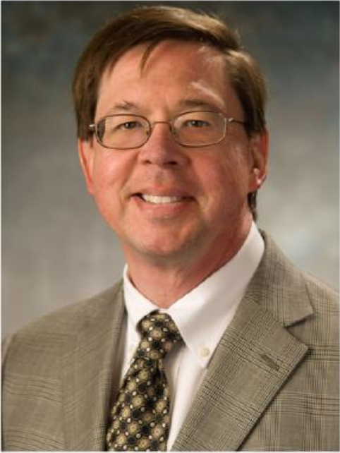
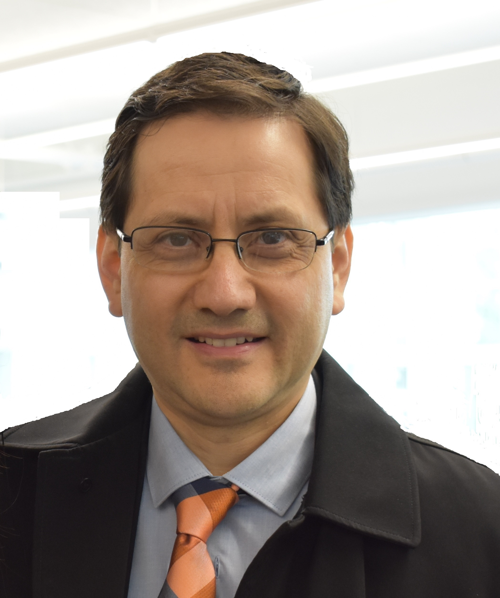
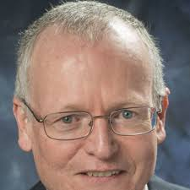
Panel Session:
Application of system engineering principles to generate robust designs
Beth Wilson
Certified Architect
Certified Six Sigma Expert
Raytheon (Ret.)
Randy Roberts
Senior Fellow
Otis Elevator Company
Clas Jacobson
Senior Fellow
Carrier Corporation
Victor Rivas
Senior Project Manager
JACOBS

Slide 2
Application of system engineering principles to generate robust designs
Ed Medri - Moderator’s Introduction
Robust Design is a methodology for designing systems that are insensitive to the variation they are likely to experience in use – Dr. Genichi Taguchi (1950’s)
Robust System Engineering transforms product development into a more predictable, more manageable, closed loop process – Martin Coe, CSEP (2019)

Slide 3


Application of system engineering principles to generate robust designs
Beth Wilson
Robust: In Use
  Stakeholder Engagement – include user perspective
  Mission Scenarios – use and misuse cases
  Integrated Testing – operationally relevant
Robust: Product Development
  Requirements – contract for test, MOE/MOP focus
  Interfaces – reduce complexity for integration
  MBSE – single source of truth

Slide 4
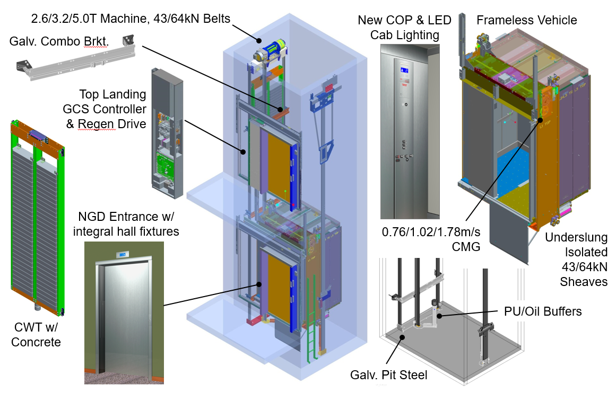
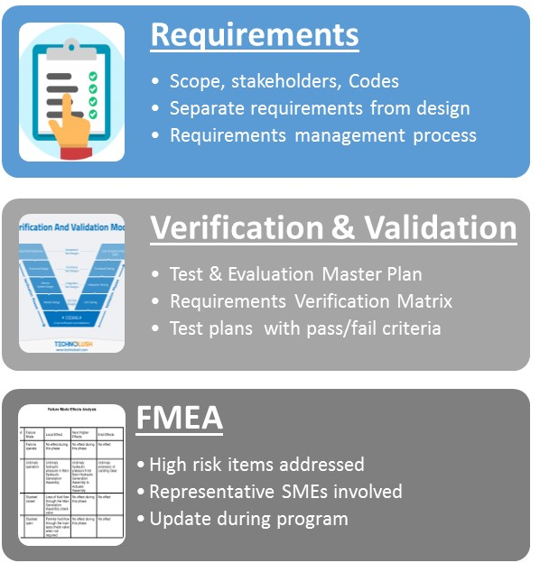
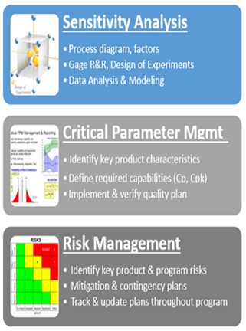
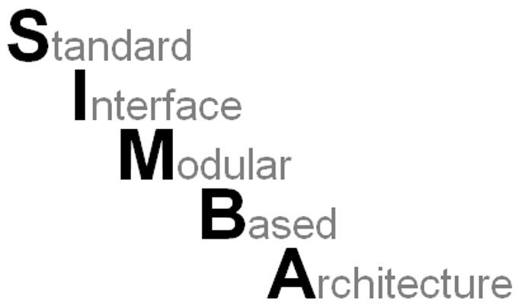
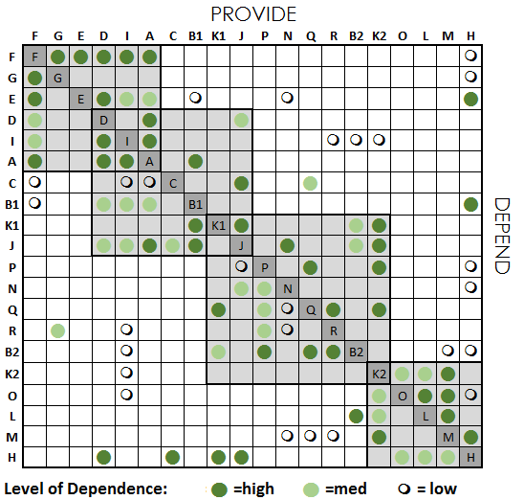
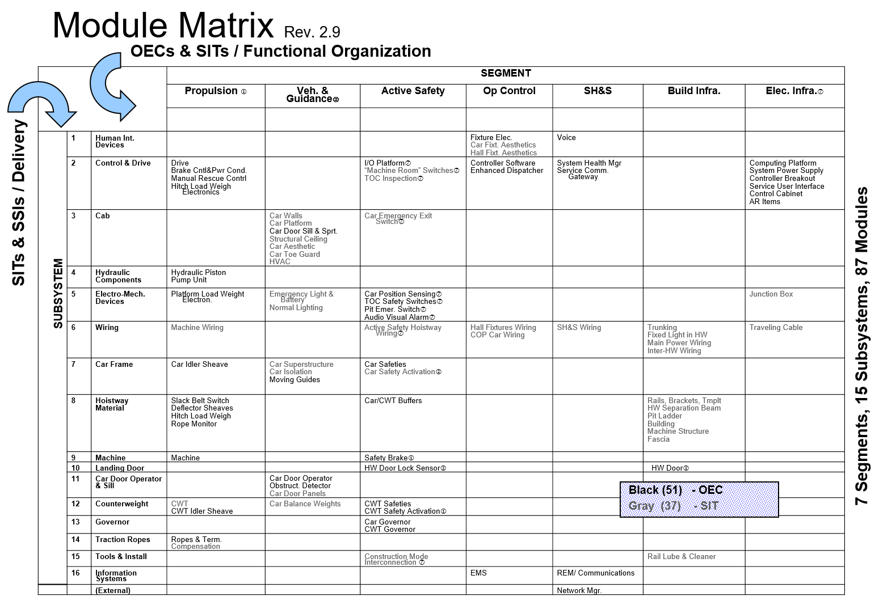
Product: Manage Interfaces
Application of system engineering principles to generate robust designs
Randy Roberts
Process: Robust Design Tools
Design Structure Matrix

Slide 5
Application of system engineering principles to generate robust designs
Clas Jacobson
Systems engineering is a methodology for product system level design, optimization and verification that:
  Provides guarantees of performance and reliability against customer requirements
  Produces modular, extensible architectures for products
  Exploits model-based analytical tools and techniques
  Coordinated execution of a prescriptive, repeatable and measurable design process

Slide 6
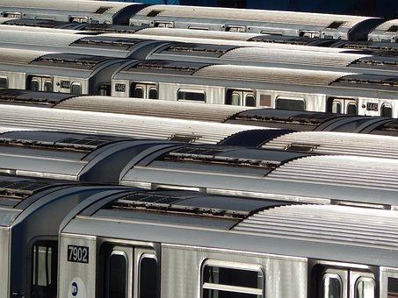
Application of system engineering principles to generate robust designs
Victor Rivas
Transit Industry Perspective
Overview of transit systems
Common challenges
  Organizational and operational silos
  Interfacing systems in constant state of renewal
Building Blocks to Robust Transit Systems
  Asset Management nexus
    Stakeholder engagement
    Towards a single source of truth
    Performance management
    Risk-based investment prioritization
  Focus on interface management
Source: Pixabay.com

Slide 7
Panel Session:
Application of system engineering principles to generate robust designs
Thank You !
Questions or Comments?

